Slide 1
Android Tutorial

Slide 2
Introduction for java, android and Basics of PHP.
Android UI Widgets
Working with permissions.
Working with building tool (Gradle ).
Working with external packages.
Android Push Notification, Session and Asset.
Android background services with boot option also.
Android Different Type Of Layouts.
Android Sliding Menu using Navigation Drawer
Android Custom List View with Image and Text
Android Tab Layout with Swipeable Views
Android Login and Registration Screen Design
SQLite Database, File Store and Object Store.
Android JSON Parser.
Android Login and Registration with PHP and MySQL
Working with Remote Database.
Uploading and Downloading image to local store and server(Using Camera also.)
Android GPS, Location Manager Tutorial
Real Time Android Chat Application using Firebase or Firebase Storage.
Cloud Messaging using Firebase.
Sharing Data to social media.

Slide 3

Android Tutorial
Android is a complete set of software for mobile devices such as tablet computers, notebooks, smartphones, electronic book readers, set-top boxes etc.
It contains a linux-based Operating System, middleware and key mobile applications.
It can be thought of as a mobile operating system. But it is not limited to mobile only. It is currently used in various devices such as mobiles, tablets, televisions etc.

Slide 4
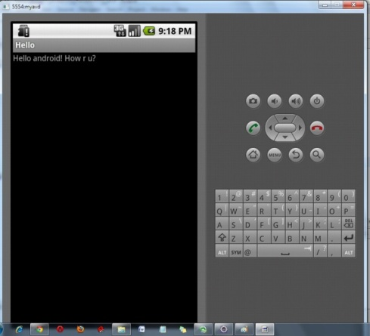
Android Emulator
Android Emulator is used to run, debug and test the android application.
If you don't have the real device, it can be the best way to run, debug and test the application.
In IDE, you can create AVD by Window menu > AVD Manager > New.
In the given image, you can see the android emulator, it displays the output of the hello android example.

Slide 5
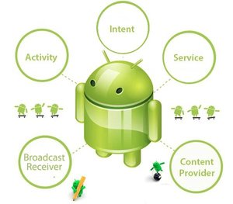
Android Core Building Blocks

Slide 6
Android Core Building Blocks
An android component is simply a piece of code that has a well defined life cycle e.g. Activity, Receiver, Service etc.
The core building blocks or fundamental components of android are activities, views, intents, services, content providers,
fragments and AndroidManifest.xml.
Activity
An activity is a class that represents a single screen. It is like a Frame in AWT.
View
A view is the UI element such as button, label, text field etc. Anything that you see is a view.

Slide 7
Intent
Intent is used to invoke components. It is mainly used to:
Start the service
Launch an activity
Display a web page
Display a list of contacts
Broadcast a message
Dial a phone call etc.
For example, you may write the following code to view the webpage.
Intent intent=new Intent(Intent.ACTION_VIEW);
intent.setData(Uri.parse("http://www.netarchitec.com"));
startActivity(intent);

Slide 8
Service
Service is a background process that can run for a long time.
There are two types of services local and remote. Local service is accessed from within the application whereas remote service is accessed remotely from other applications running on the same device.
Content Provider
Content Providers are used to share data between the applications.
Fragment
Fragments are like parts of activity. An activity can display one or more fragments on the screen at the same time.

Slide 9
AndroidManifest.xml
It contains informations about activities, content providers, permissions etc. It is like the web.xml file in Java EE.
Android Virtual Device (AVD)
It is used to test the android application without the need for mobile or tablet etc. It can be created in different configurations to emulate different types of real devices.
Android R.java file
Android R.java is an auto-generated file by aapt (Android Asset Packaging Tool) that contains resource IDs for all the resources of res/ directory.
If you create any component in the activity_main.xml file, id for the corresponding component is automatically created in this file.

Slide 10
AndroidManifest.xml file in android
The AndroidManifest.xml file contains information of your package, including components of the application such as activities, services, broadcast receivers, content providers etc.
It performs some other tasks also:
It is responsible to protect the application to access any protected parts by providing the permissions.
It also declares the android api that the application is going to use.
It lists the instrumentation classes. The instrumentation classes provides profiling and other informations.
These informations are removed just before the application is published etc.
This is the required xml file for all the android application and located inside the root directory.
A simple AndroidManifest.xml file looks like this:

Slide 11
How to make Android apps

Slide 12
In Android Studio, create a new project:
If you don't have a project opened, in the Welcome to Android Studio window, click Start a new Android Studio project.
If you have a project opened, select File > New Project.
In the New Project screen, enter the following values:
Application Name: "My First App"
Company Domain: "example.com“
You might want to change the project location, but leave the other options as they are
Click Next.
In the Target Android Devices screen, keep the default values and click Next..
In the Add an Activity to Mobile screen, select Empty Activity and click Next.
In the Customize the Activity screen, keep the default values and click Finish.

Slide 13
After some processing, Android Studio opens the IDE. Now take a moment to review the most important files.
First, be sure the Project window is open (select View > Tool Windows > Project) and the Android view is selected from the drop-down list at the top of that window.
You can then see the following files:
app > java > com.example.myfirstapp > MainActivity.java
This is the main activity (the entry point for your app). When you build and run the app, the system launches an instance of this Activity and loads its layout.
app > res > layout > activity_main.xml
This XML file defines the layout for the activity's UI. It contains a TextView element with the text "Hello world!".
app > manifests > AndroidManifest.xml
The manifest file describes the fundamental characteristics of the app and defines each of its components.
Gradle Scripts > build.gradle
You'll see two files with this name: one for the project and one for the "app" module. Each module has its own build.gradle file, but this project currently has just one module. You'll mostly work with the module's build.gradle file to configure how the Gradle tools compile and build your app.

Slide 14
Build a Simple User Interface

Slide 15
package com.example.helloandroid;
import android.os.Bundle;
import android.app.Activity;
import android.view.Menu;
import android.widget.TextView;
public class MainActivity extends Activity {
@Override
protected void onCreate(Bundle savedInstanceState) {
super.onCreate(savedInstanceState);
}
}

Slide 16
onCreate(Bundle savedInstanceState) Function in Android:
When an Activity first call or launched then onCreate(Bundle savedInstanceState) method is responsible to create the activity.
When ever orientation(i.e. from horizontal to vertical or vertical to horizontal) of activity gets changed or when an Activity gets forcefully terminated by any Operating System then savedInstanceState i.e. objectof Bundle Class will save the state of an Activity.
After Orientation changed then onCreate(Bundle savedInstanceState) will call and recreate the activity and load all data from savedInstanceState.
Basically Bundle class is used to stored the data of activity whenever above condition occur in app.
onCreate() is not required for apps. But the reason it is used in app is because that method is the best place to put initialization code.
You could also put your initialization code in onStart() or onResume() and when you app will load first, it will work same as in onCreate().

Slide 18
Constraint layout

Slide 19
The constraint layout was first figured out at Google I/O 2016 aiming to introduce auto layout for android but what it is actually and how it’s going to impact layout designing.
Well the prime concern for the developer is layout selection whether to go with Relative, Linear, Frame or Percentage Relative layout and in case of any change in the UI thereafter will add up an extra overhead and sometime in worst case scenario it may leads to recreating the entire layout.
To avoid such problem android is having a perfect layout named constraint layout.
How do I add constraint layout? Constraint layout dependency have to be added to gradle file and that’s it you are ready to go!
dependencies
{ compile ‘com.android.support.constraint:constraint-layout:1.0.2’ }

Slide 20
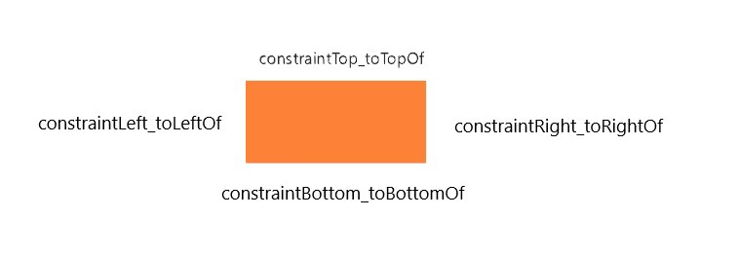
Now as you are ready to go the first and foremost thing that you have to do is replace the parent layout with ConstraintLayout.
The view inside constraint layout have to be defined through the constraints like to the left/right/top/bottom of the view by default all view take the position of top left corner if constraints are not defined.

Slide 21
The available attributes are:
layout_constraintLeft_toLeftOf layout_constraintLeft_toRightOf layout_constraintRight_toLeftOf layout_constraintRight_toRightOf layout_constraintTop_toTopOf layout_constraintTop_toBottomOf layout_constraintBottom_toTopOf layout_constraintBottom_toBottomOf layout_constraintBaseline_toBaselineOf layout_constraintStart_toEndOf layout_constraintStart_toStartOf layout_constraintEnd_toStartOf layout_constraintEnd_toEndOf

Slide 22
How to position view?
There are a set of attributes to position a view. The constraintLeft_toLeftOf attribute will put the view at the left side of the corresponding view similarly constraintRight_toRightOf will put the view on the right side.
Whereas constraintTop_toTopOf will align the view right on the top on the view as if they are overlapping same case with constraintBottom_toBottomOf.
So if you want your view on the top of another view then you have to use constraintBottom_toTopOf.
What this does is that it will align your view bottom side with the corresponding view top side hence your view will come on the top of that view.

Slide 23
Take an advantage of percentage system
The new concept is bias system what this does is that you will define the percentage of the screen the view should move forward or downward ranging for 0 to 100%.
The most important part is that width has to wrap content if horizontal bias is used and height to be wrap content if vertical bias is used. Attributes used for this are
layout_constraintHorizontal_bias
layout_constraintVertical_bias
<TextView android:layout_width="wrap_content" android:layout_height="wrap_content" app:layout_constraintHorizontal_bias="0.5" app:layout_constraintLeft_toLeftOf="parent" app:layout_constraintRight_toRightOf="parent"/>
This will position the textview to the 50% of the screen. In case you want to position based some view than use constraintLeft_toRightOf and use id of that view after this it will calculate percentage based on that view not from the screen.

Slide 24
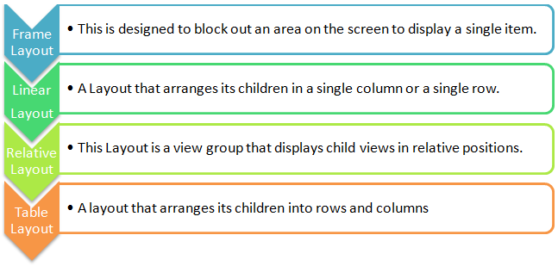

Slide 25
Android Toast
Andorid Toast can be used to display information for the short period of time. A toast contains message to be displayed quickly and disappears after sometime
Toast.makeText(getApplicationContext(),"Hello Netacrhitec",Toast.LENGTH_SHORT).show();
public class MainActivity extends Activity {
@Override
public void onCreate(Bundle savedInstanceState) {
super.onCreate(savedInstanceState);
setContentView(R.layout.activity_main);
//Displaying Toast with Hello Javatpoint message
Toast.makeText(getApplicationContext(),"Hello Netacrhic",Toast.LENGTH_SHORT).show();
}
@Override
public boolean onCreateOptionsMenu(Menu menu) {
getMenuInflater().inflate(R.menu.activity_main, menu);
return true;
}
}

Slide 26
Android CheckBox Example
android checkbox
Android CheckBox is a type of two state button either checked or unchecked.
There can be a lot of usage of checkboxes. For example, it can be used to know the hobby of the user, activate/deactivate the specific action etc.
<CheckBox
android:id="@+id/checkBox1"
android:layout_width="wrap_content"
android:layout_height="wrap_content"
android:layout_alignParentLeft="true"
android:layout_alignParentTop="true"
android:text="Pizza" />

Slide 27
CheckBox chk;
public void addListenerOnButtonClick(){
//Getting instance of CheckBoxes and Button from the activty_main.xml file
chk=(CheckBox)findViewById(R.id.checkBox1);
//Applying the Listener on the Button click
buttonOrder.setOnClickListener(new OnClickListener(){
@Override
public void onClick(View view) {
if(chk.isChecked()){
Toast.makeText(getApplicationContext(), ”Hi” Toast.LENGTH_LONG).show();
}
}
});

Slide 28
Android WebView Example
Android WebView is used to display web page in android.
WebView mywebview = (WebView) findViewById(R.id.webView1);
mywebview.loadUrl("http://www.netarchitec.com/");

Slide 29
<RelativeLayout xmlns:android="http://schemas.android.com/apk/res/android"
xmlns:tools="http://schemas.android.com/tools"
android:layout_width="match_parent"
android:layout_height="match_parent"
tools:context=".MainActivity" >
<WebView
android:id="@+id/webView1"
android:layout_width="match_parent"
android:layout_height="match_parent"
android:layout_alignParentTop="true"
android:layout_centerHorizontal="true"
android:layout_marginTop="42dp" />
</RelativeLayout>

Slide 30
@Override
protected void onCreate(Bundle savedInstanceState)
{
super.onCreate(savedInstanceState);
setContentView(R.layout.activity_main);
WebView web = (WebView) findViewById(R.id.webView1);
web.setWebChromeClient(new WebChromeClient());
web.setWebViewClient(new WebViewClient());
web.loadUrl("http://www.netarchitec.com/");
}

Slide 31
mWebView.setDownloadListener(new DownloadListener()
{
@Override public void onDownloadStart(String url, String userAgent, String contentDisposition, String mimetype, long contentLength)
{
DownloadManager.Request request = new DownloadManager.Request( Uri.parse(url)); request.allowScanningByMediaScanner(); request.setNotificationVisibility(DownloadManager.Request.VISIBILITY_VISIBLE_NOTIFY_COMPLETED); //Notify client
once download is completed!
request.setDestinationInExternalPublicDir(Environment.DIRECTORY_DOWNLOADS, "Name of your downloadble file goes here, example: Mathematics II ");
DownloadManager dm = (DownloadManager) getSystemService(DOWNLOAD_SERVICE);
dm.enqueue(request);
//To notify the Client that the file is being downloaded
Toast.makeText(getApplicationContext(), "Downloading File", Toast.LENGTH_LONG).show(); } });
<uses-permission android:name="android.permission.WRITE_EXTERNAL_STORAGE" />

Slide 32
Android DatePicker
Android DatePicker is a widget to select date. It allows you to select date by day, month and year. Like DatePicker, android also provides TimePicker to select time.
<TextView
android:id="@+id/textView1"
android:layout_width="wrap_content"
android:layout_height="wrap_content"
android:layout_alignParentLeft="true"
android:layout_alignParentTop="true"
android:layout_marginLeft="50dp"
android:layout_marginTop="36dp"
android:text="Current Date:" />
<DatePicker
android:id="@+id/datePicker1"
android:layout_width="wrap_content"
android:layout_height="wrap_content"
android:layout_above="@+id/button1"
android:layout_centerHorizontal="true"
android:layout_marginBottom="30dp" />
<Button
android:id="@+id/button1"
android:layout_width="wrap_content"
android:layout_height="wrap_content"
android:layout_alignParentBottom="true"
android:layout_centerHorizontal="true"
android:layout_marginBottom="140dp"
android:text="Change Date" />

Slide 33
@Override
protected void onCreate(Bundle savedInstanceState) {
super.onCreate(savedInstanceState);
setContentView(R.layout.activity_main);
textview1=(TextView)findViewById(R.id.textView1);
picker=(DatePicker)findViewById(R.id.datePicker1);
displayDate=(Button)findViewById(R.id.button1);
textview1.setText(getCurrentDate());
displayDate.setOnClickListener(new OnClickListener(){
@Override
public void onClick(View view) {
textview1.setText(getCurrentDate());
}
});
}

Slide 34
public String getCurrentDate(){
StringBuilder builder=new StringBuilder();
builder.append("Current Date: ");
builder.append((picker.getMonth() + 1)+"/");//month is 0 based
builder.append(picker.getDayOfMonth()+"/");
builder.append(picker.getYear());
return builder.toString();
}

Slide 35
Start Another Activity

Slide 36
Respond to the send button
Add a method in MainActivity.java that's called by the button as follows:
In the file app > java > com.example.myfirstapp > MainActivity.java, add the sendMessage() method stub as shown below:
public class MainActivity extends AppCompatActivity { @Override protected void onCreate(Bundle savedInstanceState) { super.onCreate(savedInstanceState); setContentView(R.layout.activity_main); } /** Called when the user taps the Send button */ public void sendMessage(View view) { // Do something in response to button } }

Slide 37
Build an Intent
An Intent is an object that provides runtime binding between separate components, such as two activities. The Intent represents an app’s "intent to do something." You can use intents for a wide variety of tasks, but in this lesson, your intent starts another activity.
In MainActivity.java, add the EXTRA_MESSAGE constant and the sendMessage() code, as shown here:
public class MainActivity extends AppCompatActivity { public static final String EXTRA_MESSAGE = "com.example.myfirstapp.MESSAGE"; @Override protected void onCreate(Bundle savedInstanceState) { super.onCreate(savedInstanceState); setContentView(R.layout.activity_main); } /** Called when the user taps the Send button */ public void sendMessage(View view) { Intent intent = new Intent(this, DisplayMessageActivity.class); EditText editText = (EditText) findViewById(R.id.editText); String message = editText.getText().toString(); intent.putExtra(“msg”, message); startActivity(intent); } }

Slide 38
Android Studio will again encounter Cannot resolve symbol errors, so press Alt + Enter (or Option + Return on Mac).
Your imports should end up as the following:
import android.content.Intent; import android.support.v7.app.AppCompatActivity; import android.os.Bundle; import android.view.View; import android.widget.EditText;

Slide 39
Create the second activity
In the Project window, right-click the app folder and select New > Activity > Empty Activity.
In the Configure Activity window, enter "DisplayMessageActivity" for Activity Name and click Finish (leave all other properties set to the defaults).
Android Studio automatically does three things:
Creates the DisplayMessageActivity.java file.
Creates the corresponding activity_display_message.xml layout file.
Adds the required <activity> element in AndroidManifest.xml.

Slide 40
Display the message
Now you will modify the second activity to display the message that was passed by the first activity.
In DisplayMessageActivity.java, add the following code to the onCreate() method:
@Override protected void onCreate(Bundle savedInstanceState) { super.onCreate(savedInstanceState); setContentView(R.layout.activity_display_message); // Get the Intent that started this activity and extract the string Intent intent = getIntent(); String message = intent.getStringExtra(“msg”); // Capture the layout's TextView and set the string as its text TextView textView = (TextView) findViewById(R.id.textView); textView.setText(message); }

Slide 41
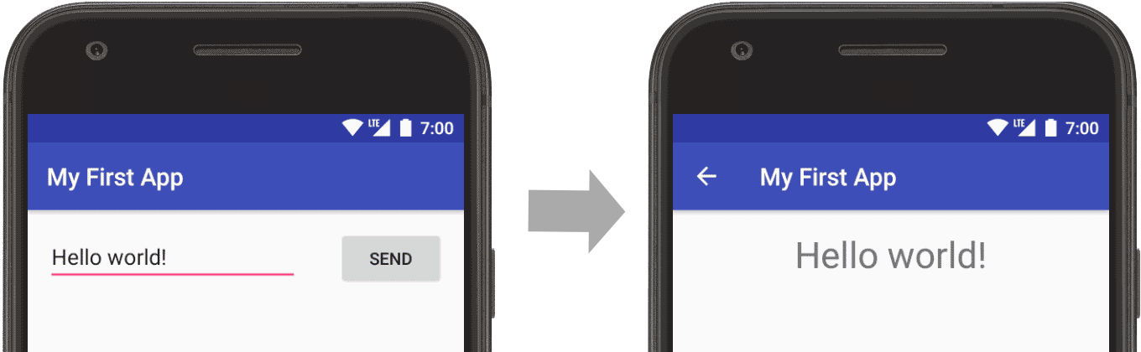

Slide 42
Add Permissions to the Manifest
To protect the system's integrity and the user's privacy, Android runs each app in a limited access sandbox.
If the app wants to use resources or information outside of its sandbox, the app has to explicitly request permission.
Depending on the type of permission the app requests, the system may grant the permission automatically, or the system may ask the user to grant the permission.

Slide 43
To declare that your app needs a permission, put a <uses-permission> element in your app manifest, as a child of the top-level <manifest> element.
For example, an app that needs to send SMS messages would have this line in the manifest:
<manifest xmlns:android="http://schemas.android.com/apk/res/android" package="com.example.snazzyapp"> <uses-permission android:name="android.permission.SEND_SMS"/> <uses-permission android:name="android.permission.READ_EXTERNAL_STORAGE" />
<application ...> ... </application> </manifest>

Slide 44

Run on an emulator
Before you run your app on an emulator, you need to create an Android Virtual Device (AVD) definition. An AVD definition specifies the characteristics of an Android phone, tablet, Android Wear, or Android TV device that you want to simulate in the Android Emulator.
Create an AVD Definition as follows:
Launch the Android Virtual Device Manager by selecting Tools > Android > AVD Manager, or by clicking the AVD Manager icon in the toolbar.
In the Your Virtual Devices screen, click Create Virtual Device.
In the Select Hardware screen, select a phone device, such as Pixel, and then click Next.
In the System Image screen, click Download for one of the recommended system images. Agree to the terms to complete the download.
After the download is complete, select the system image from the list and click Next.
On the next screen, leave all the configuration settings as they are and click Finish.
Back in the Your Virtual Devices screen, select the device you just created and click Launch this AVD in the emulator .
While the emulator starts up, close the Android Virtual Device Manager window and return to your project so you can run the app:
Once the emulator is booted up, click the app module in the Project window and then select Run > Run (or click Run in the toolbar).
In the Select Deployment Target window, select the emulator and click OK.
Android Studio installs the app on the emulator and starts it.

Slide 45
<manifest xmlns:android="http://schemas.android.com/apk/res/android"
package="com.javatpoint.hello"
android:versionCode="1"
android:versionName="1.0" >
<uses-sdk
android:minSdkVersion="8"
android:targetSdkVersion="15" />
<application
android:icon="@drawable/ic_launcher"
android:label="@string/app_name"
android:theme="@style/AppTheme" >
<activity
android:name=".MainActivity"
android:label="@string/title_activity_main" >
<intent-filter>
<action android:name="android.intent.action.MAIN" />
<category android:name="android.intent.category.LAUNCHER" />
</intent-filter>
</activity>
</application>
</manifest>

Slide 46
Android - Login Screen

Slide 47
A login application is the screen asking your credentials to login to some particular application. You might have seen it when logging into facebook,twitter e.t.c
<EditText android:id = "@+id/editText2" android:layout_width = "wrap_content" android:layout_height = "wrap_content" android:inputType = "textPassword" />
<EditText android:id = "@+id/editText1" android:layout_width = "wrap_content" android:layout_height = "wrap_content" />
<Button android:id = "@+id/button1" android:layout_width = "wrap_content" android:layout_height = "wrap_content" android:onClick = "login" android:text = "@string/Login" />

Slide 48
In the java file, inside the method of onClick get the username and passwords text using getText() and toString() method and match it with the text using equals() function.
EditText username = (EditText)findViewById(R.id.editText1);
EditText password = (EditText)findViewById(R.id.editText2);
public void login(View view)
{
if(username.getText().toString().equals("admin") && password.getText().toString().equals("admin"))
{
//correcct password
}
else{
//wrong password
}

Slide 49
Following is the content of AndroidManifest.xml file.
<?xml version="1.0" encoding="utf-8"?>
<manifest xmlns:android="http://schemas.android.com/apk/res/android" package="com.example.sairamkrishna.myapplication" >
<application android:allowBackup="true" android:icon="@mipmap/ic_launcher" android:label="@string/app_name" android:theme="@style/AppTheme" >
<activity android:name=".MainActivity" android:label="@string/app_name" >
<intent-filter> <action android:name="android.intent.action.MAIN" />
<category android:name="android.intent.category.LAUNCHER" />
</intent-filter>
</activity>
</application>
</manifest>

Slide 50
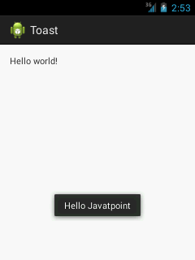
Toast class
Toast.makeText(getApplicationContext(),"Hello Javatpoint",Toast.LENGTH_SHORT).show();
package com.example.toast;
import android.os.Bundle;
import android.app.Activity;
import android.view.Menu;
import android.view.View;
import android.widget.Toast;
public class MainActivity extends Activity {
@Override
public void onCreate(Bundle savedInstanceState) {
super.onCreate(savedInstanceState);
setContentView(R.layout.activity_main);
//Displaying Toast with Hello Javatpoint message
Toast.makeText(getApplicationContext(),"Hello Javatpoint",Toast.LENGTH_SHORT).show();
}
@Override
public boolean onCreateOptionsMenu(Menu menu) {
getMenuInflater().inflate(R.menu.activity_main, menu);
return true;
}
}

Slide 51
Android AlertDialog can be used to display the dialog message with OK and Cancel buttons. It can be used to interrupt and ask the user about his/her choice to continue or discontinue.
activity_main.xml
You can have multiple components, here we are having only a textview.
File: activity_main.xml
android:layout_height="match_parent"
<RelativeLayout xmlns:androclass="http://schemas.android.com/apk/res/android"
xmlns:tools="http://schemas.android.com/tools"
android:layout_width="match_parent"
tools:context=".MainActivity" >
<TextView
android:layout_width="wrap_content"
android:layout_height="wrap_content"
android:layout_centerHorizontal="true"
android:layout_centerVertical="true"
android:text="@string/hello_world" />
</RelativeLayout>

Slide 52
strings.xml
Optionally, you can store the dialog message and title in the strings.xml file.
File: strings.xml
<?xml version="1.0" encoding="utf-8"?>
<resources>
<string name="app_name">alertdialog</string>
<string name="hello_world">Hello world!</string>
<string name="menu_settings">Settings</string>
<string name="dialog_message">Welcome to Alert Dialog</string>
<string name="dialog_title">Javatpoint Alert Dialog</string>
</resources>

Slide 53
Activity class
Let's write the code to create and show the AlertDialog.
File: MainActivity.java
package com.example.alertdialog;
import android.os.Bundle;
import android.app.Activity;
import android.app.AlertDialog;
import android.content.DialogInterface;
import android.view.Menu;
public class MainActivity extends Activity {
@Override
protected void onCreate(Bundle savedInstanceState) {
super.onCreate(savedInstanceState);
AlertDialog.Builder builder = new AlertDialog.Builder(this);
//Uncomment the below code to Set the message and title from the strings.xml file
//builder.setMessage(R.string.dialog_message) .setTitle(R.string.dialog_title);
//Setting message manually and performing action on button click
builder.setMessage("Do you want to close this application ?")
.setCancelable(false)
.setPositiveButton("Yes", new DialogInterface.OnClickListener() {
public void onClick(DialogInterface dialog, int id) {
finish();
}
})
.setNegativeButton("No", new DialogInterface.OnClickListener() {
public void onClick(DialogInterface dialog, int id) {
// Action for 'NO' Button
dialog.cancel();
}
});

Slide 54
//Creating dialog box
AlertDialog alert = builder.create();
//Setting the title manually
alert.setTitle("AlertDialogExample");
alert.show();
setContentView(R.layout.activity_main);
}
@Override
public boolean onCreateOptionsMenu(Menu menu) {
// Inflate the menu; this adds items to the action bar if it is present.
getMenuInflater().inflate(R.menu.activity_main, menu);
return true;
}
}

Slide 55
